Slide 1
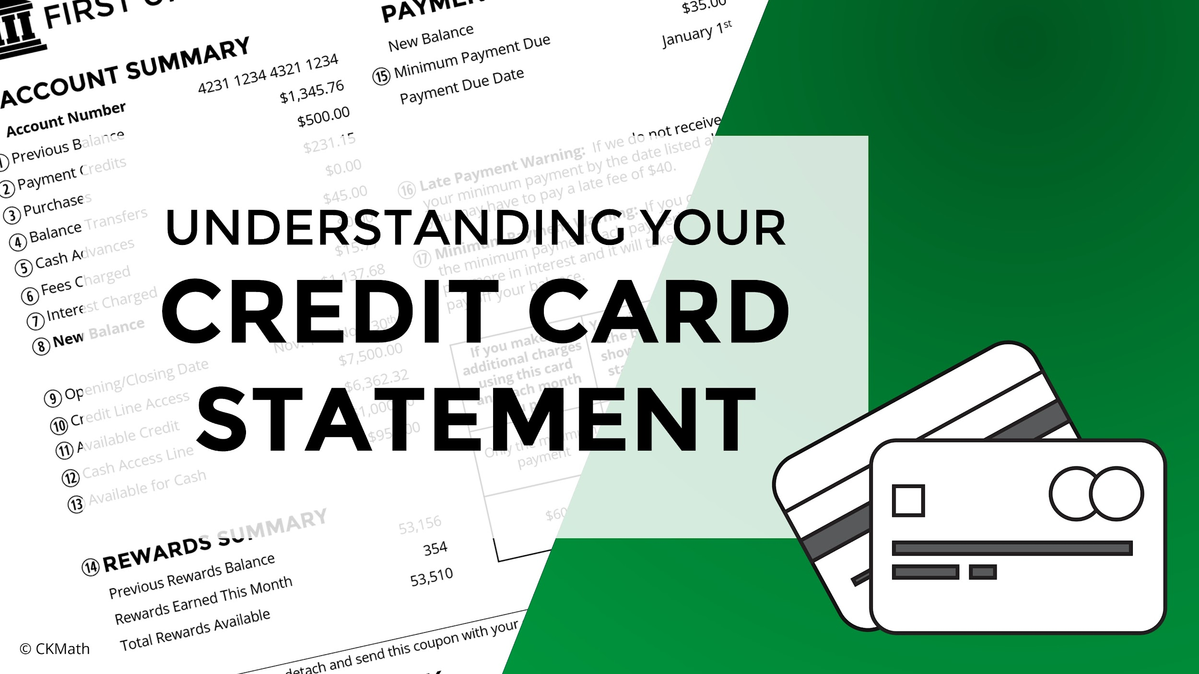
Notes:
These slides are designed to be paired with Weston’s First Student Bank credit card statement and the fill-in-the-blank notes sheet. Walk students through the following slides, then have student complete the ‘Understanding Your Credit Card Statement’ scavenger hunt that was included with this lesson. Before starting these slides and students have an opportunity to see a statement, I usually ask the class for ideas of what they think a credit card statement does and what types of information they might provide.

Slide 2
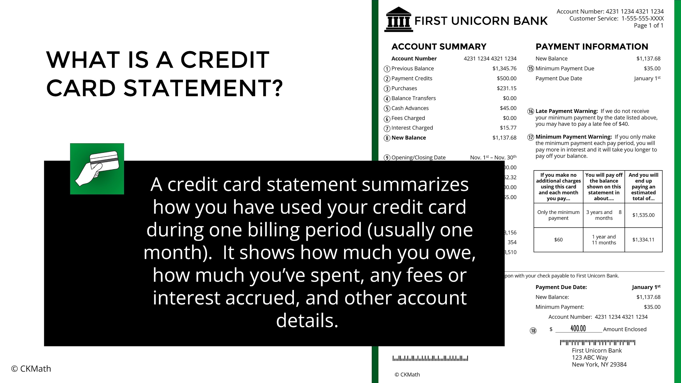
Notes:
Discuss the purpose of a credit card statement and why it is useful with students.

Slide 3
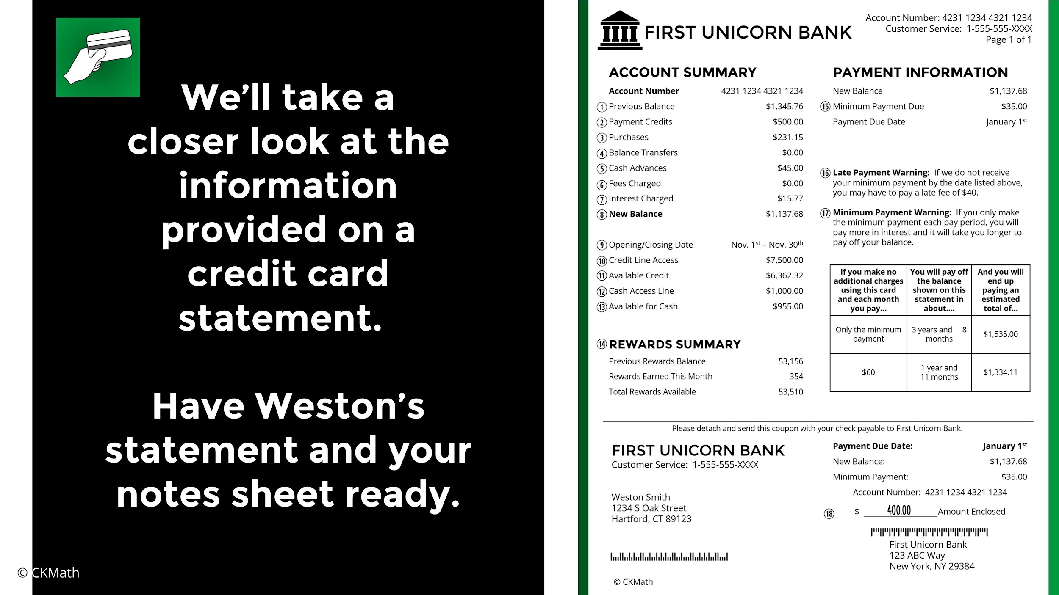
Notes:
Each student should have a copy of the fill in the blank notes and Weston’s credit card statement.

Slide 4
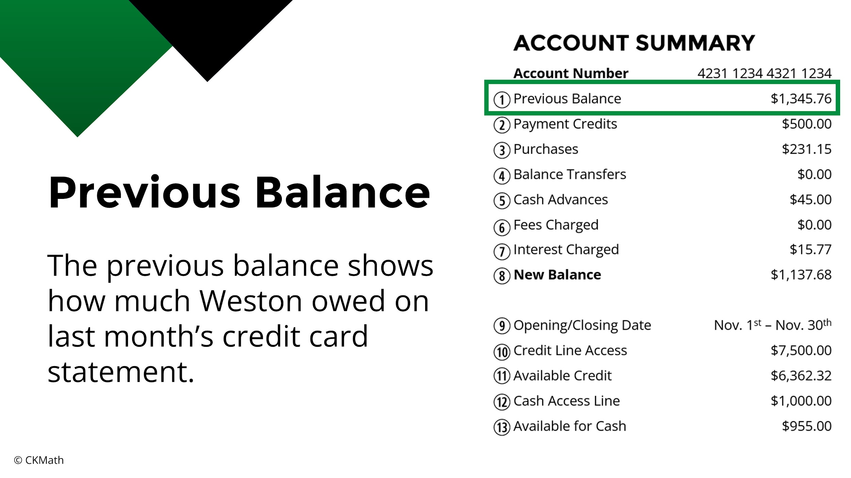
Notes:
Have students start to fill in the blanks on their notes as you go through the slides.

Slide 5
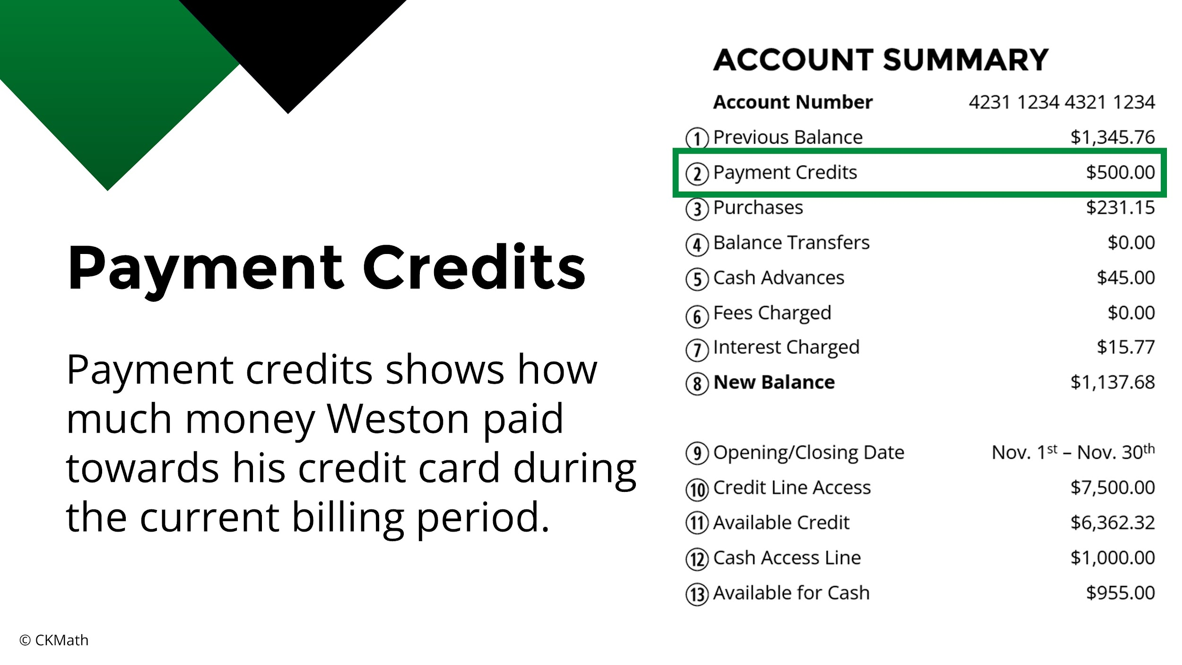

Slide 6
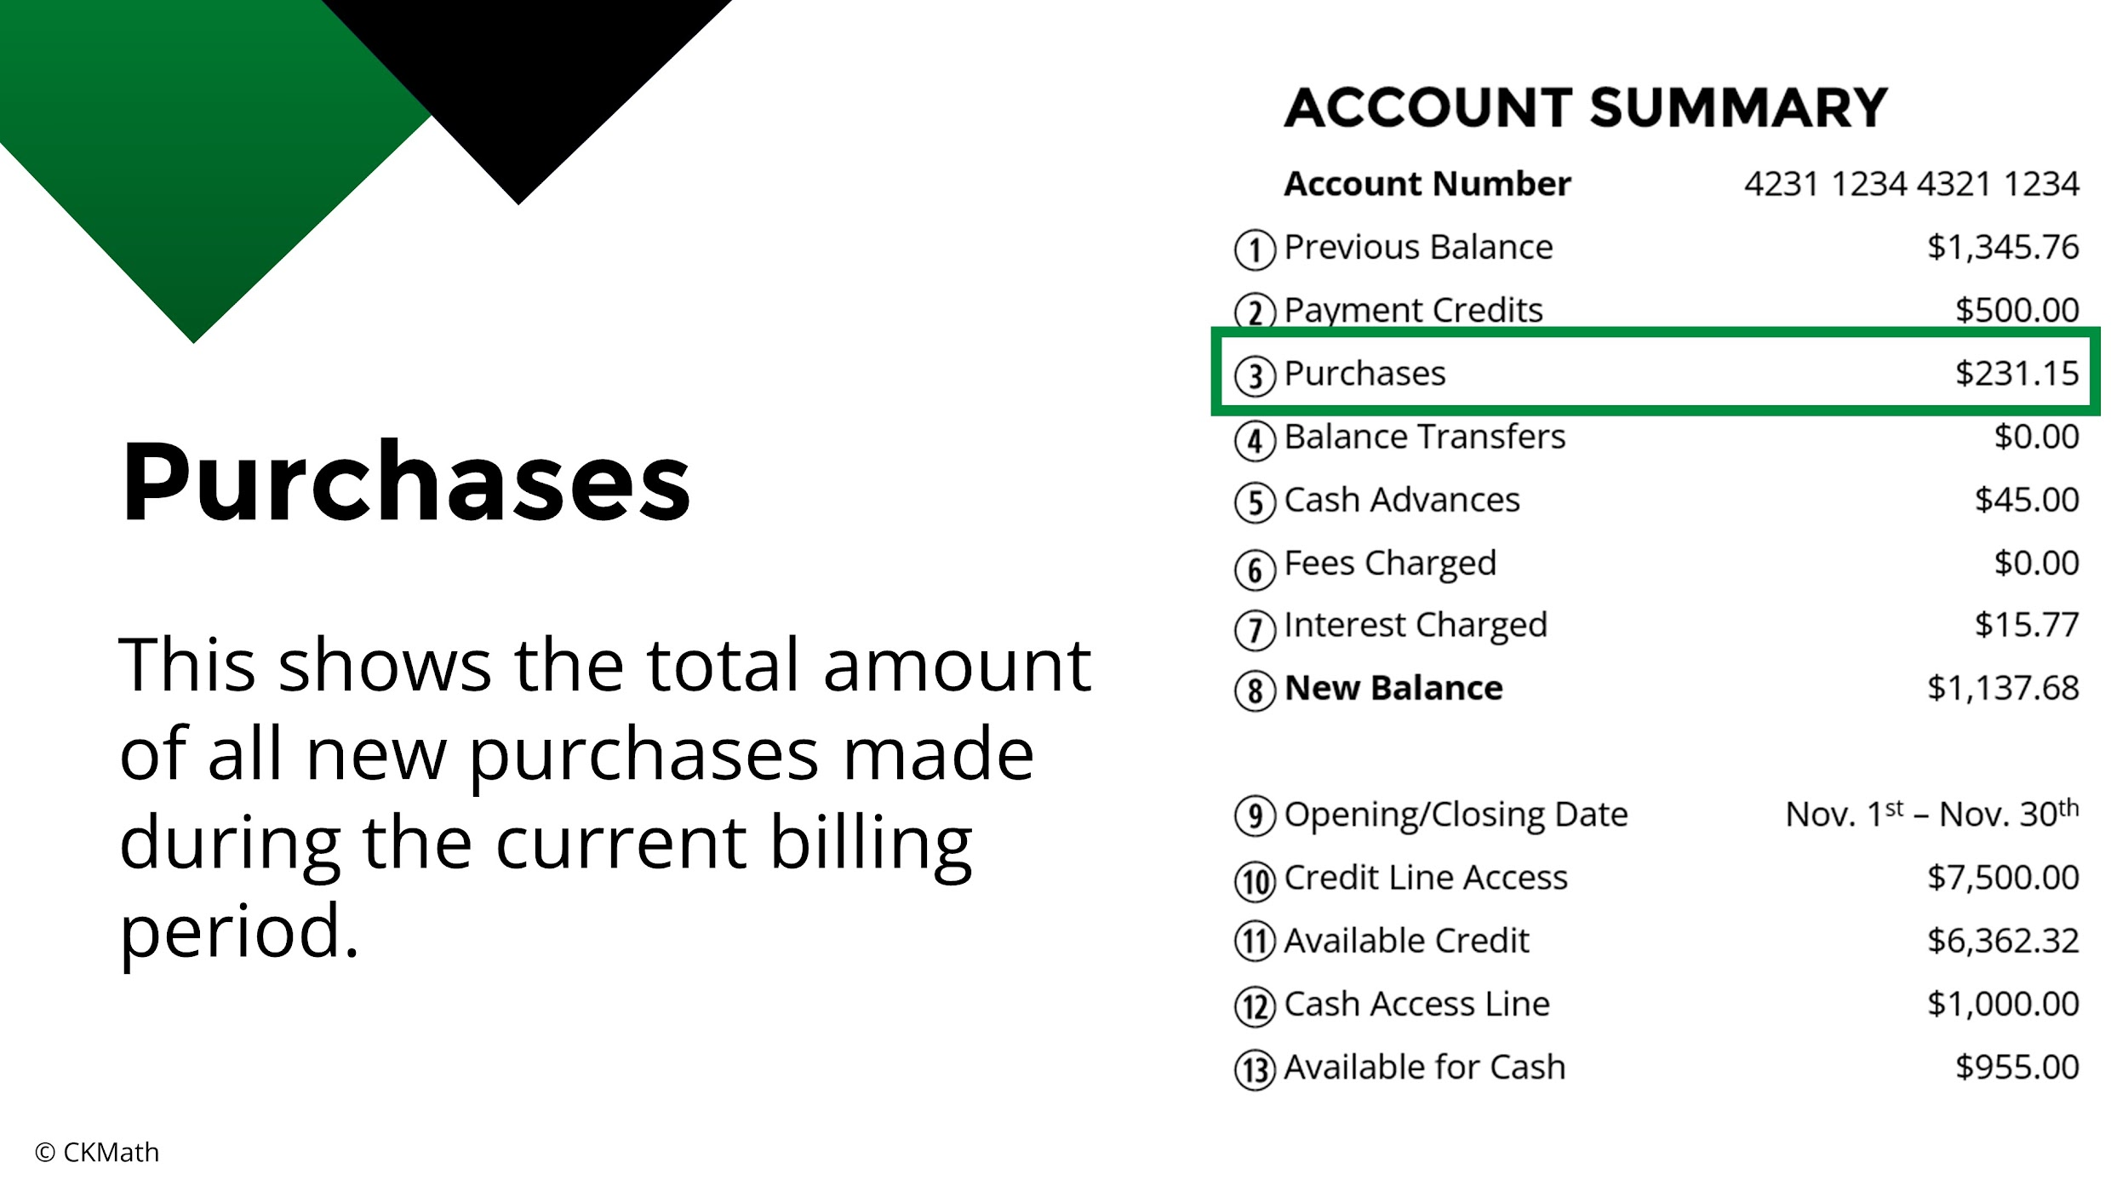

Slide 7
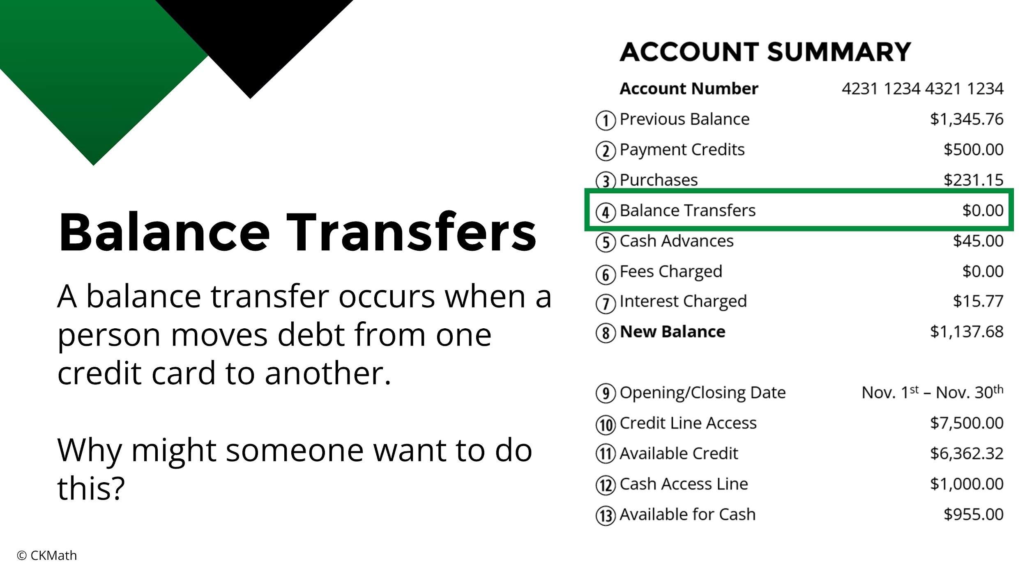
Notes:
This is a good time to pause and discuss why someone might want to do a balance transfer. Points to mention include better interest rates, consolidating debt, or potential incentives from the credit card company.

Slide 8
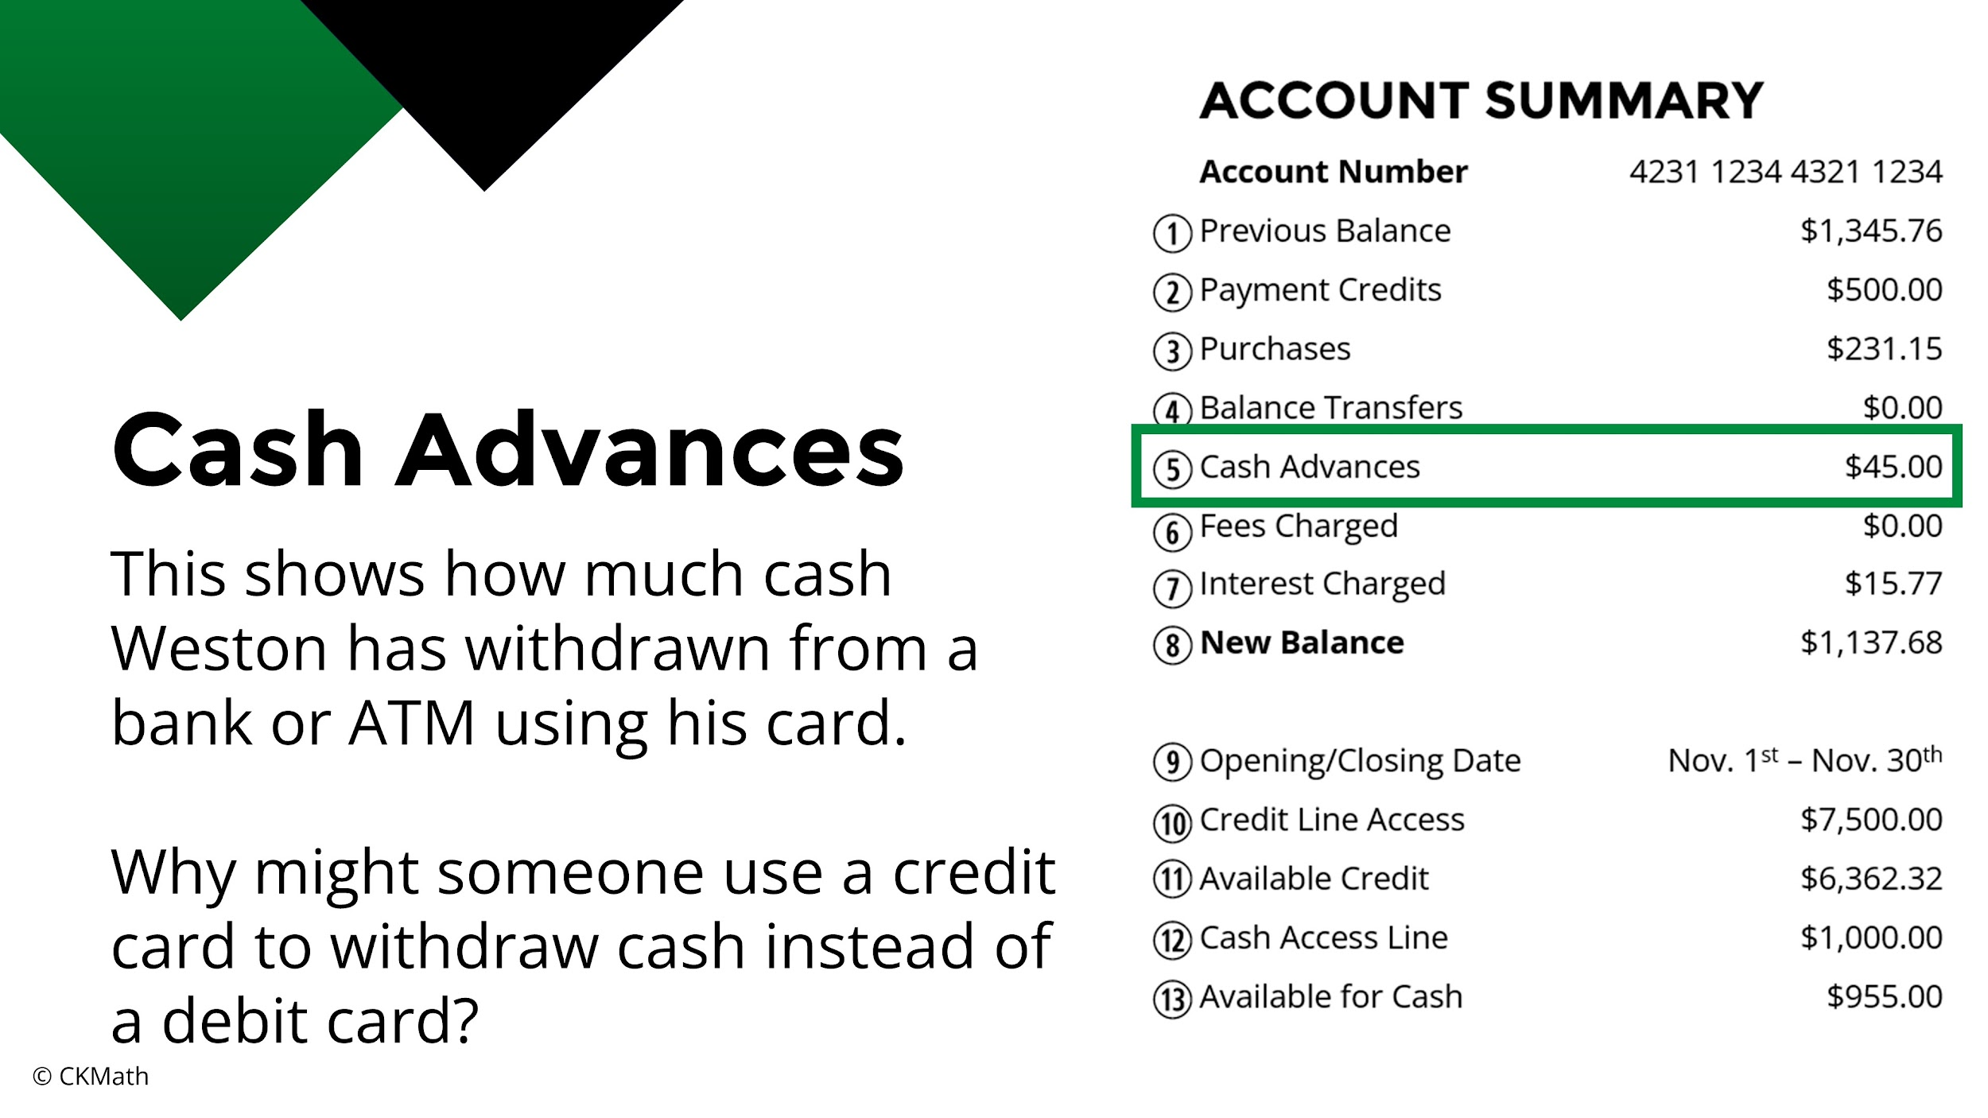
Notes:
A person might use a credit card for cash if they don’t have enough money in their bank account or haven’t received their next paycheck yet. It should be mentioned to students that it is best practice to consider cash advances from a credit card as a last resort because there can be fees and higher interest charged for cash advances.

Slide 9
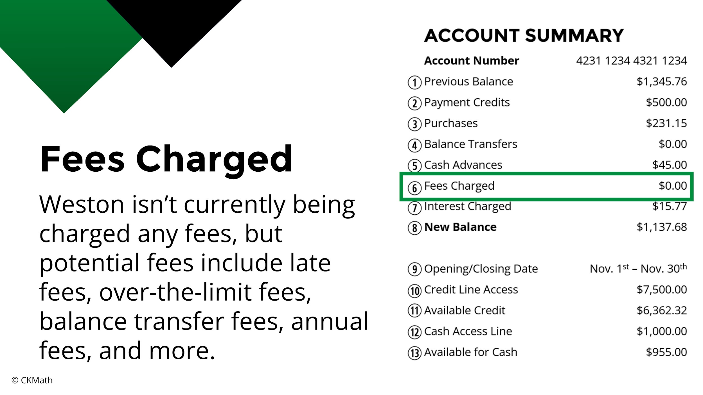
Notes:
Discuss each of the possible fees with students, especially over the limit fees and annual fees as this is the only place in this lesson they are mentioned.

Slide 10
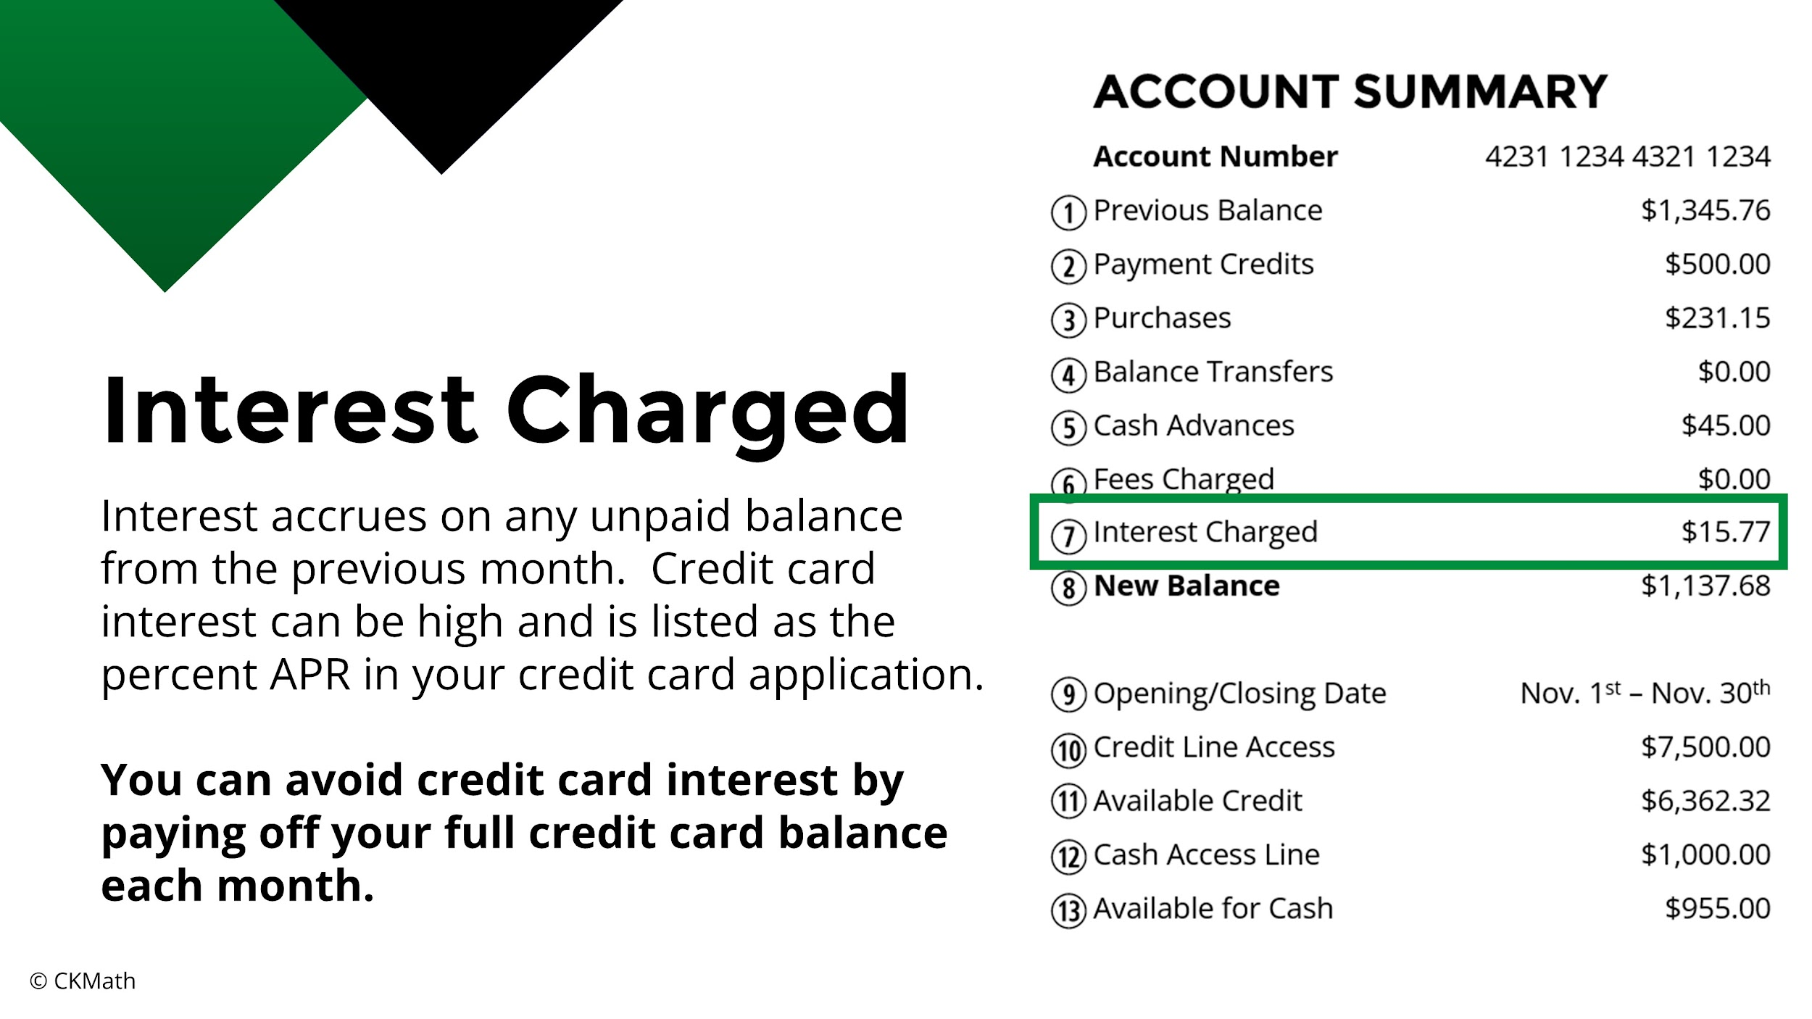
Notes:
Highlight why it is so important to pay off your entire balance each month to avoid interest.

Slide 11
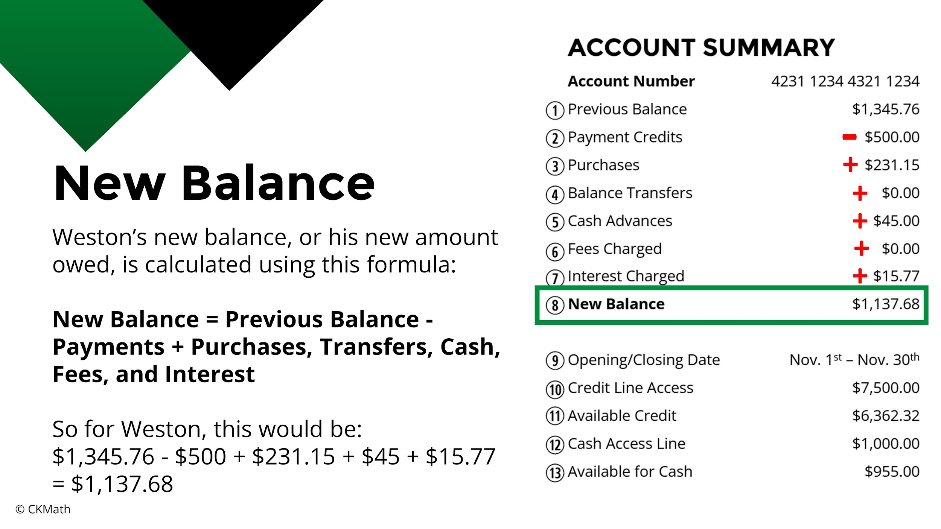
Notes:
Be sure students know how to calculate a new balance; they’ll need to know this for the scavenger hunt.

Slide 12
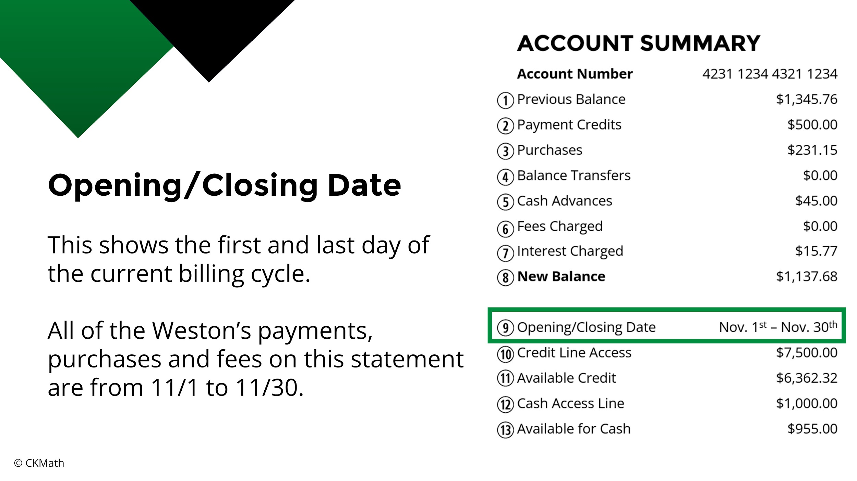

Slide 13
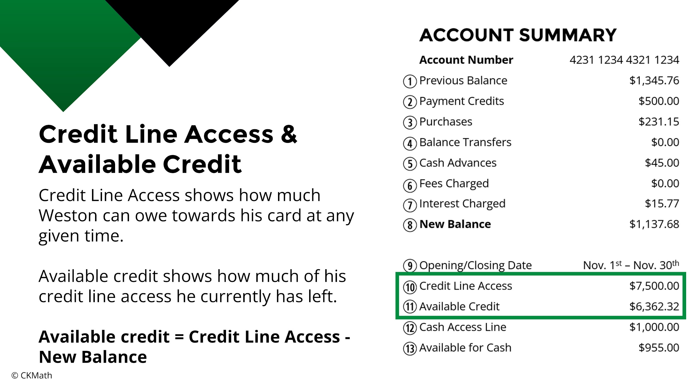
Notes:
Be sure students know how to calculate available credit; they’ll need to know this for the scavenger hunt.

Slide 14
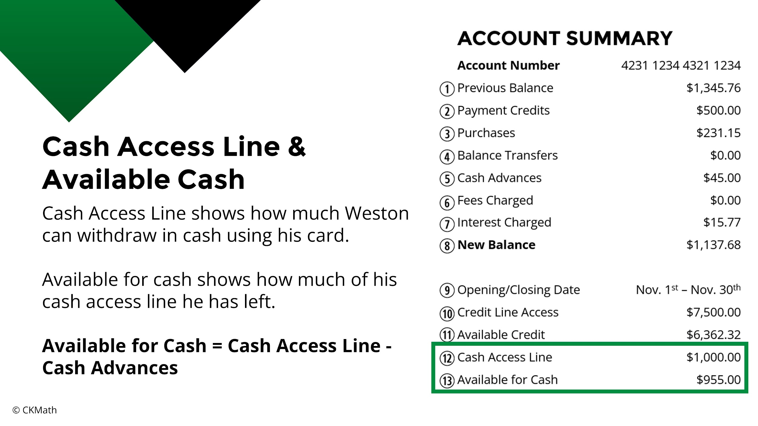
Notes:
Be sure students know how to calculate available cash; they’ll need to know this for the scavenger hunt.

Slide 15
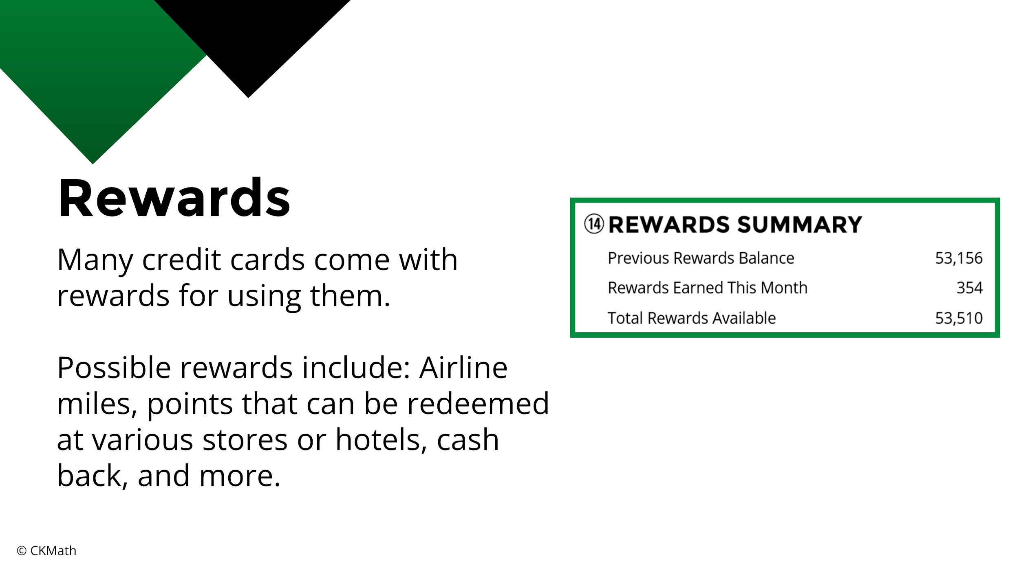

Slide 16
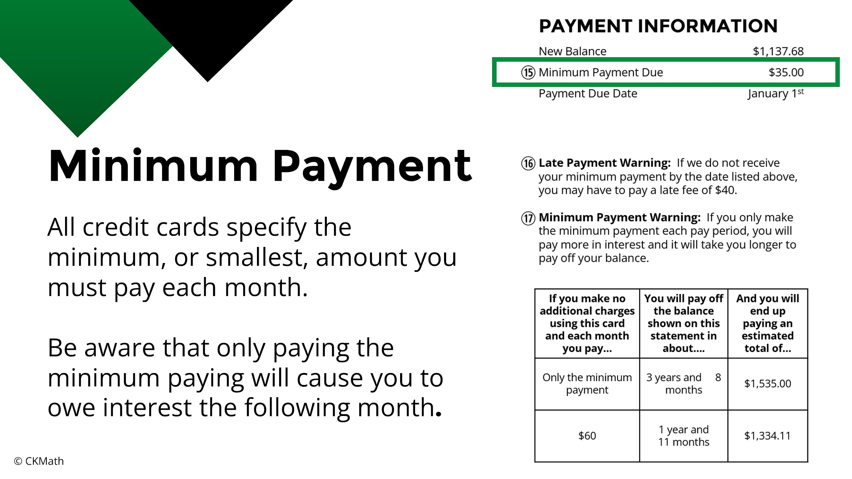
Notes:
Emphasize to students that paying only the minimum payment is not usually a good idea because of the amount of interest they will accrue. They’ll be able to see this in the minimum payment warning below.

Slide 17
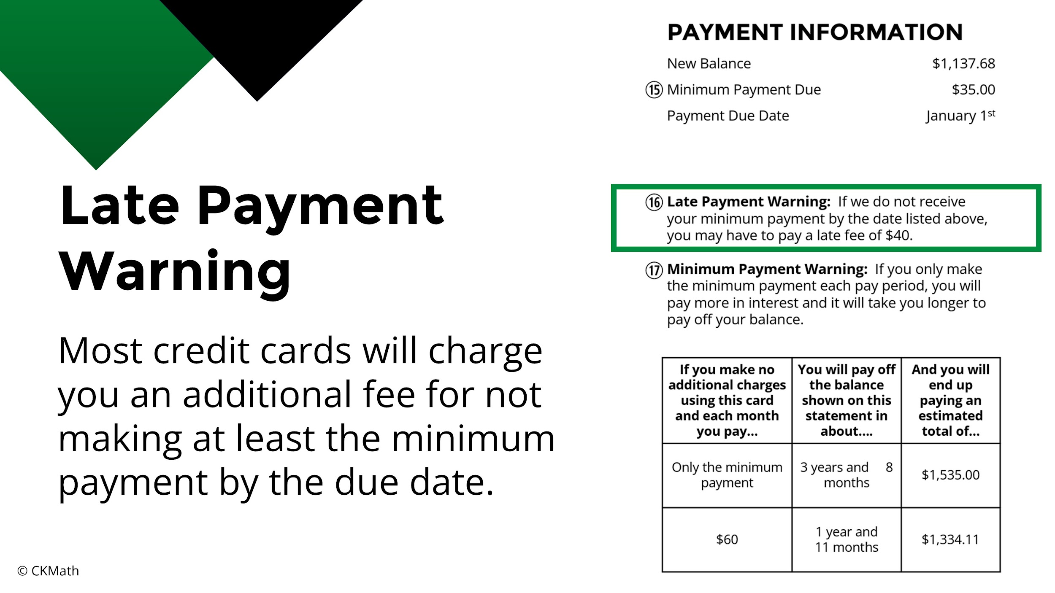

Slide 18
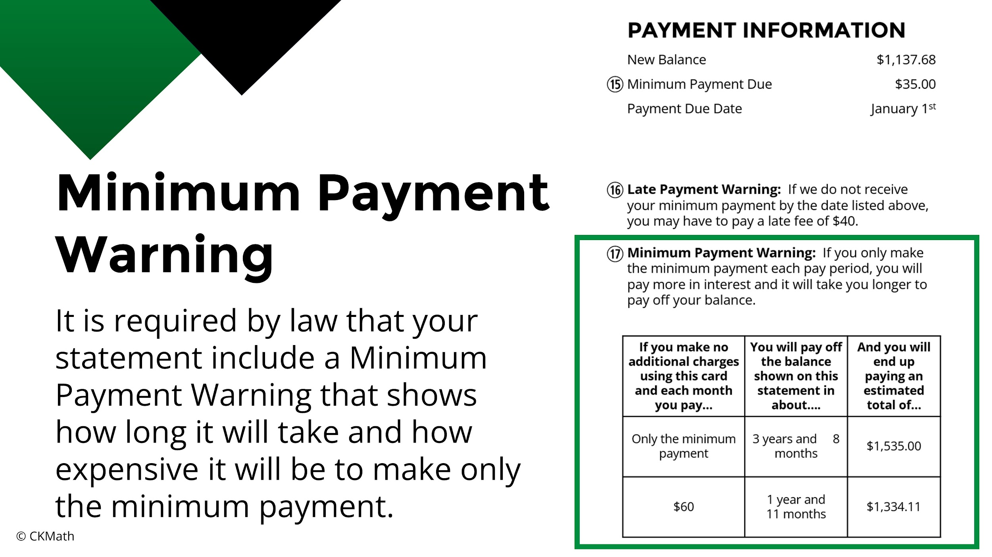
Notes:
Point out to students how expensive it can be to make small payments each month. Remind them they won’t owe any interest if they pay the full balance each month.

Slide 19
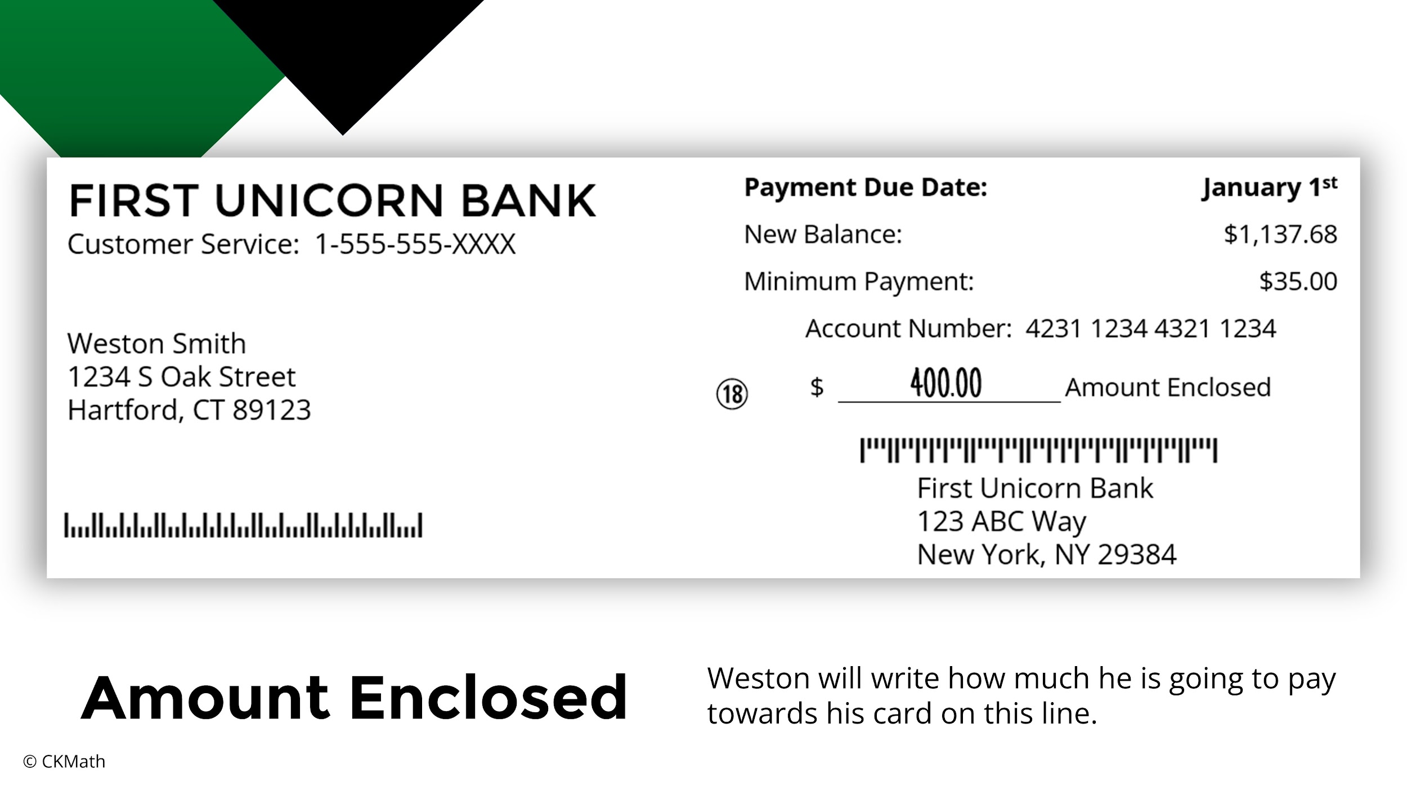
Notes:
Explain to students that Weston can pay as little as $35 or as much as $1137.68. If he pays $1137.68, he won’t owe any interest next month.

Slide 20
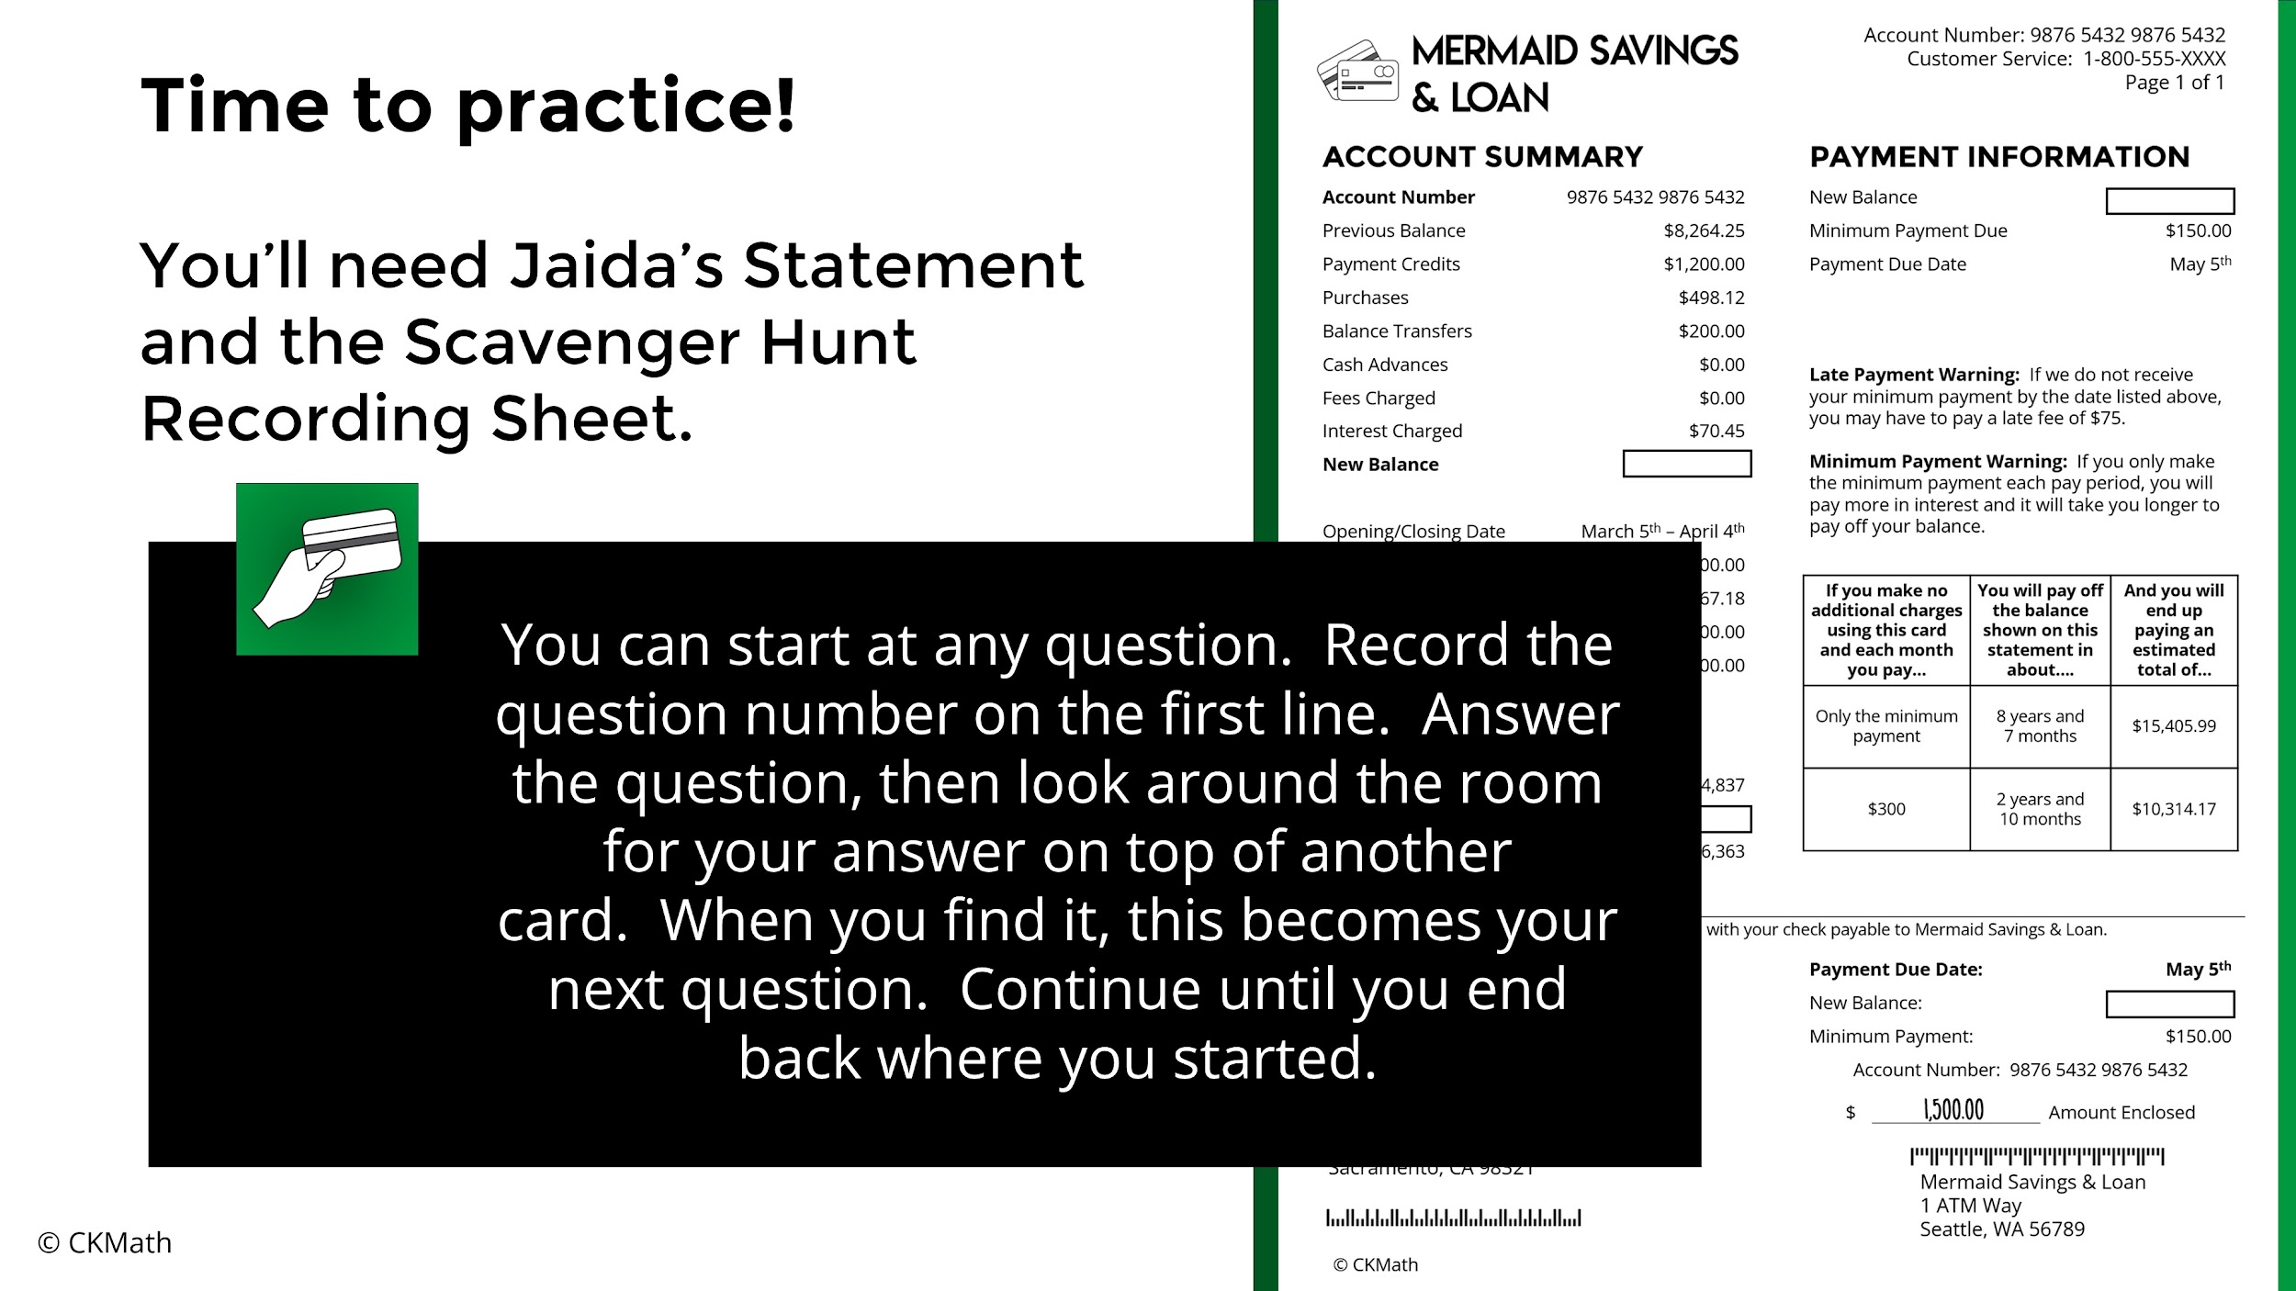
Notes:
Students will need a copy of Jaida’s statement as well as the recording sheet. You should hang the 16 scavenger hunt questions around your room in a random order prior to class starting. Make sure students understand the directions and get them started.

